Slide 1
Demystifying
Large Language Models

Slide 2
Agenda
How language models learn?
Llama-3 demonstration
Base Model vs Chat/Instruct Model

Slide 3
Machine Learning

Slide 4
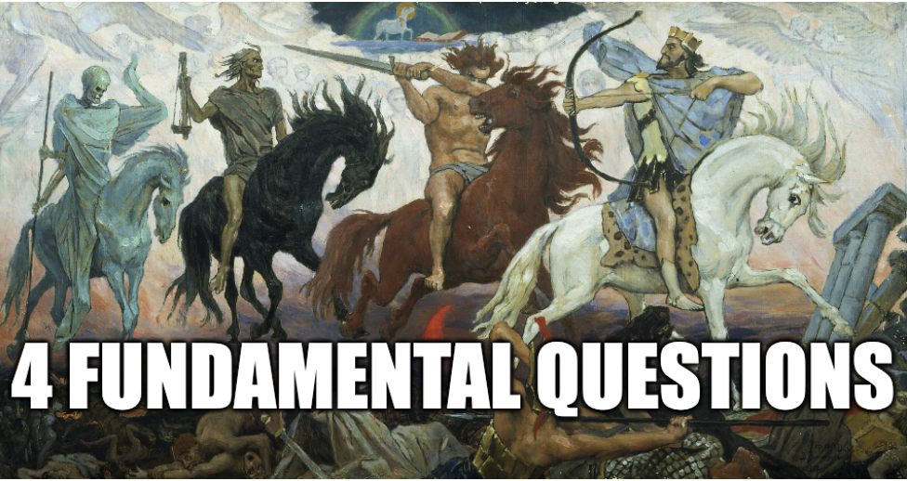
Machine Learning Model Creation
What is our input?
What is our output?
(What is our model architecture?)
What is our learning algorithm?

Slide 5
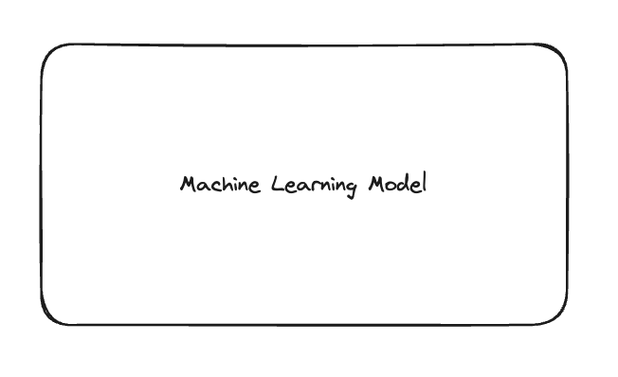
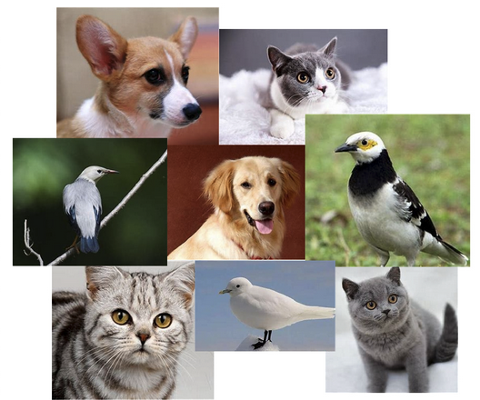
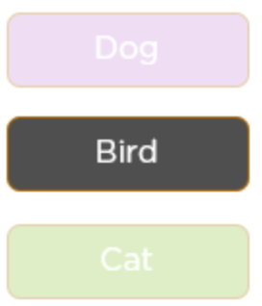
Animal classifier

Slide 6
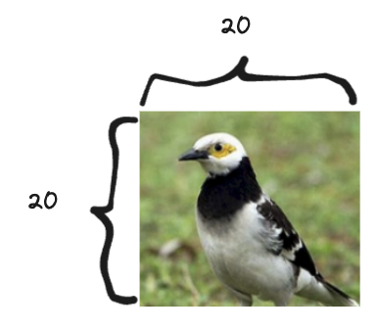
Animal classifier
What is our input?

Slide 7
Animal classifier
What is our input?

Slide 8
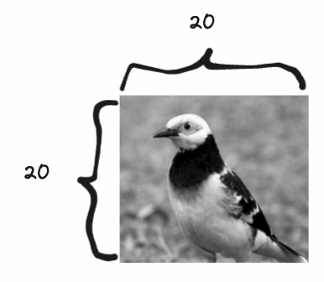
Animal classifier
What is our input?

Slide 9
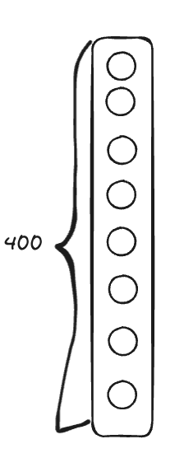
Animal classifier
What is our input?

Slide 10
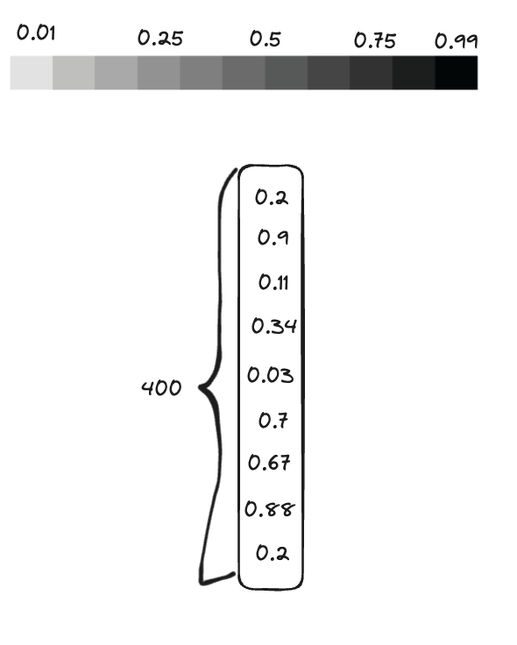
Animal classifier
What is our input?

Slide 11
Animal classifier
What is our input?

Slide 12
Animal classifier
2. What is our output?

Slide 13
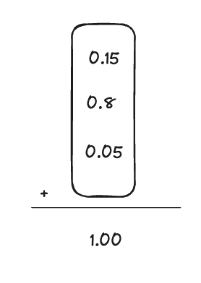
Animal classifier
2. What is our output?

Slide 14
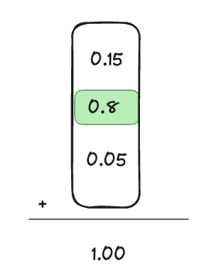
Animal classifier
2. What is our output?

Slide 15
Animal classifier
3. (What is our model architecture?)

Slide 16
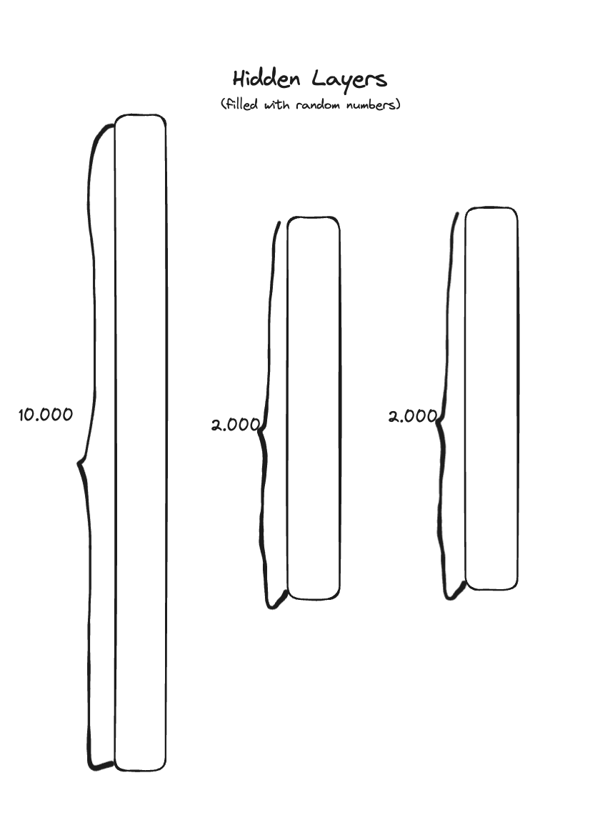
Animal classifier
3. (What is our model architecture?)

Slide 17
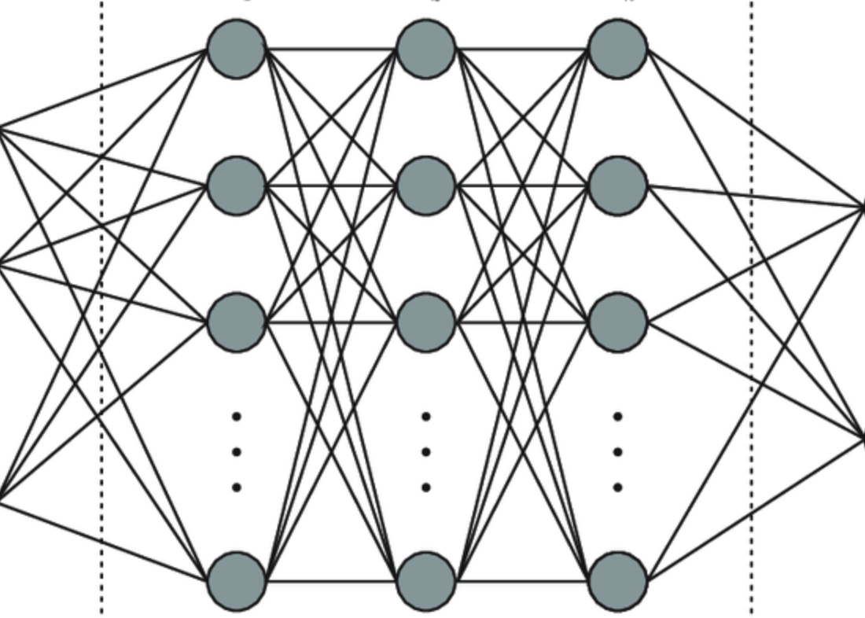
Animal classifier
3. (What is our model architecture?)

Slide 18
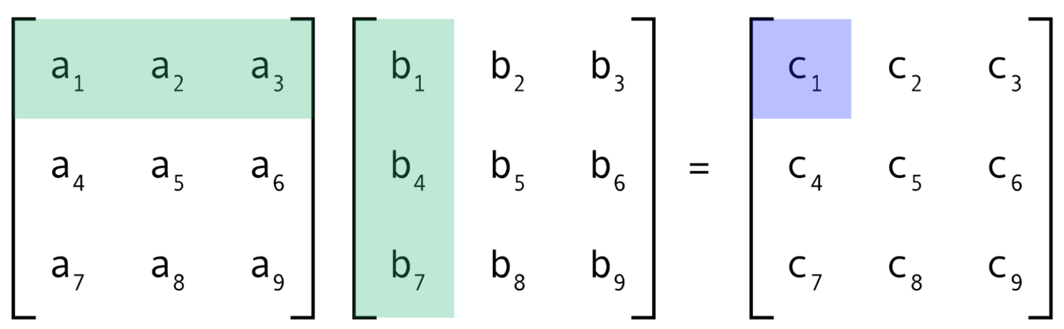
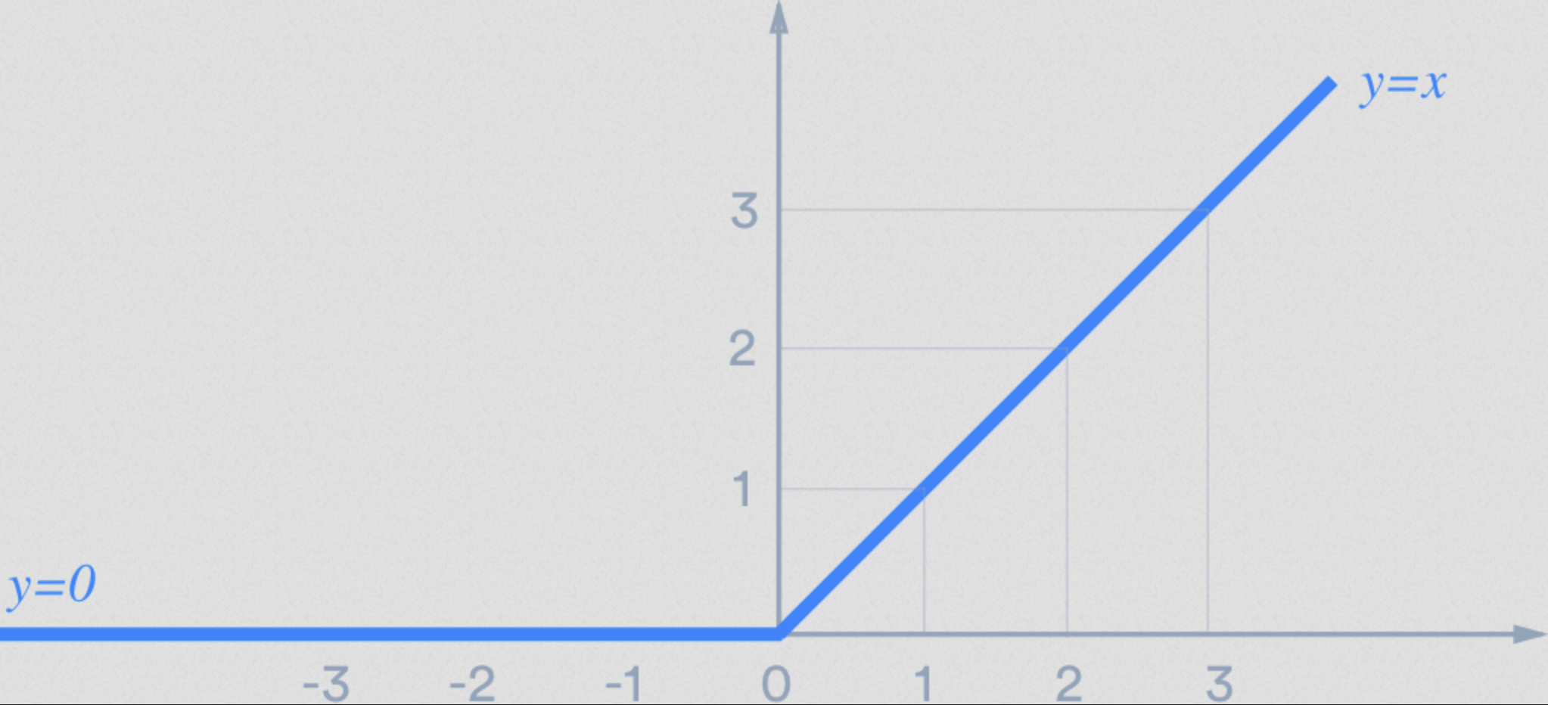
Animal classifier
3. (What is our model architecture?)

Slide 19
Animal classifier
4. What is our learning algorithm?

Slide 20
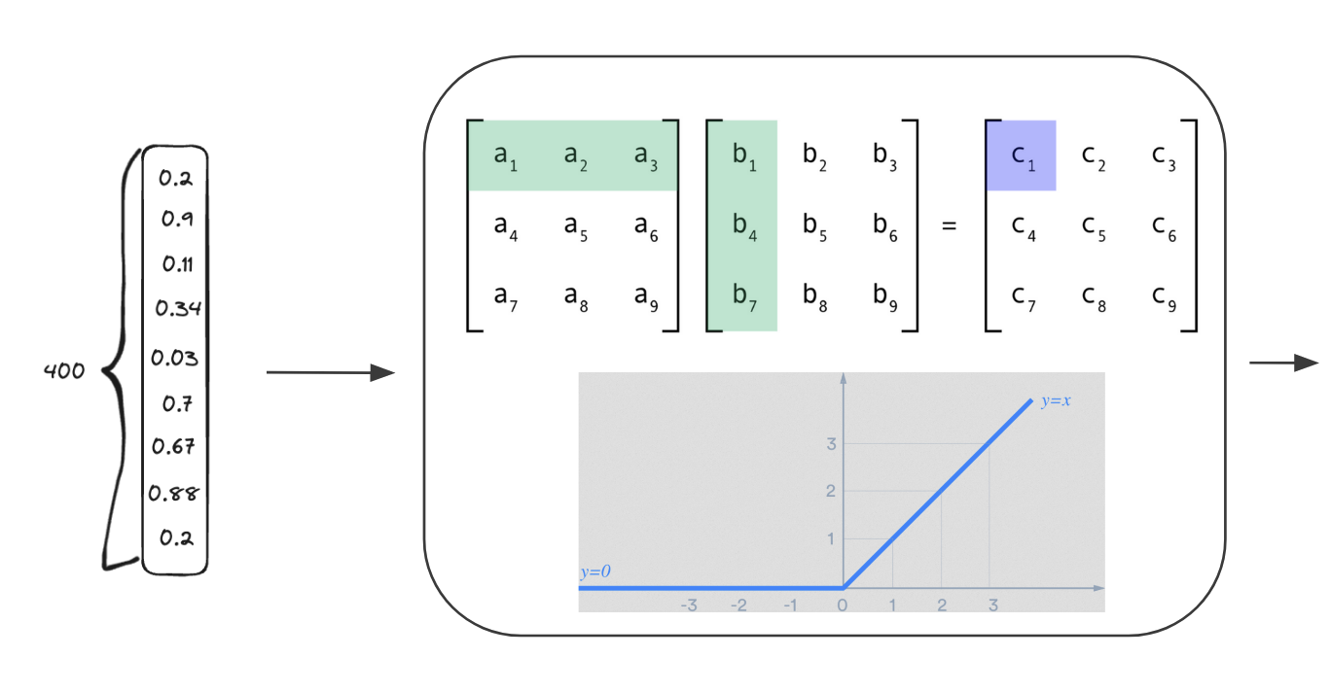
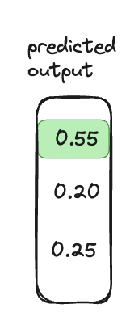
Animal classifier
4. What is our learning algorithm?

Slide 21
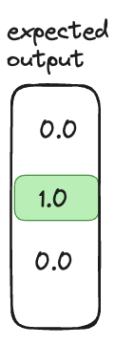
Animal classifier
4. What is our learning algorithm?

Slide 22
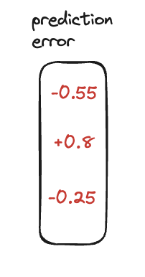
Animal classifier
4. What is our learning algorithm?

Slide 23
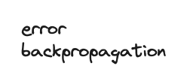
Animal classifier
4. What is our learning algorithm?

Slide 24
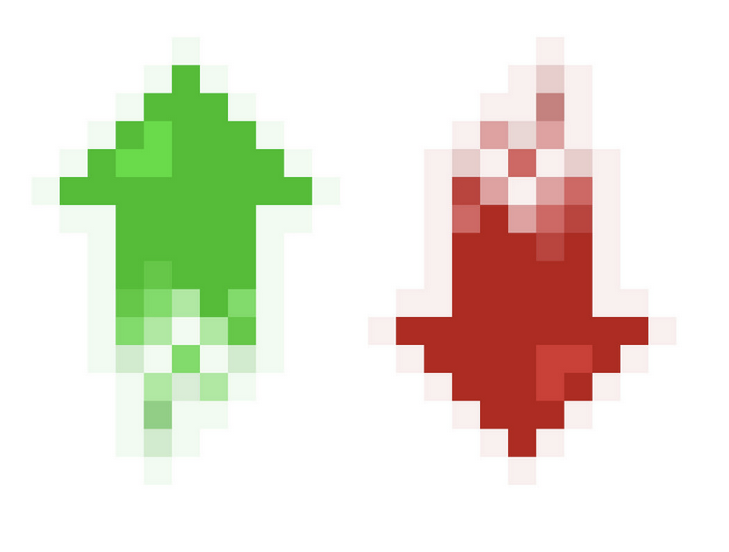
Animal classifier
4. What is our learning algorithm?

Slide 25
Machine “Learning”

Slide 26
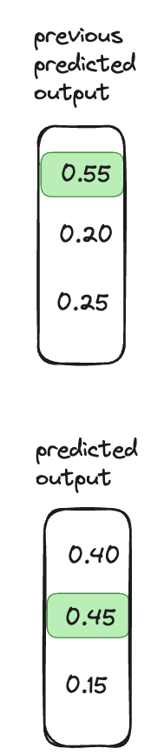
Animal classifier
4. What is our learning algorithm?

Slide 27
Animal classifier
4. What is our learning algorithm?

Slide 28
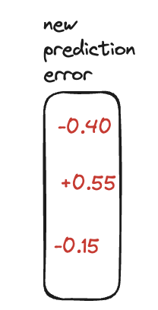
Animal classifier
4. What is our learning algorithm?

Slide 29
Animal classifier
4. What is our learning algorithm?

Slide 30
Animal classifier
4. What is our learning algorithm?

Slide 31
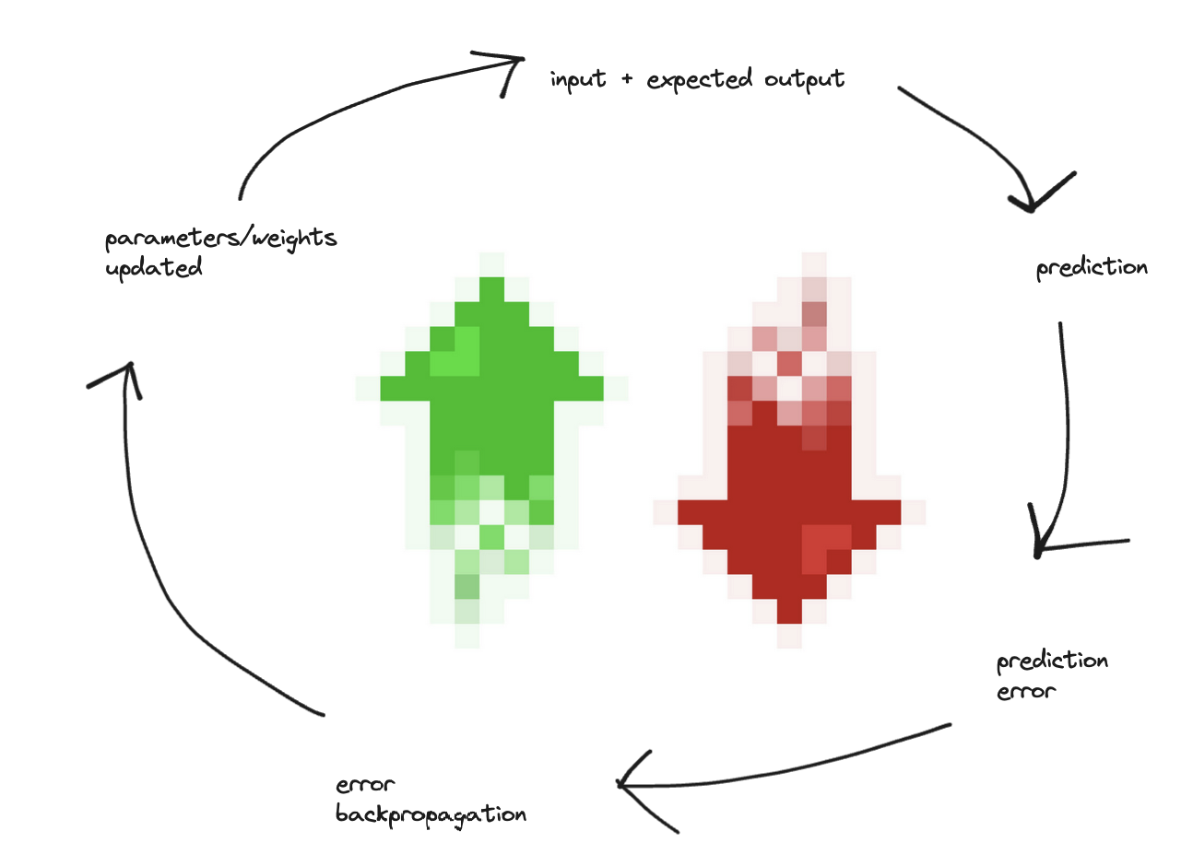
Machine “Learning” Training Loop

Slide 32
Machine “Learning” Training Loop

Slide 33
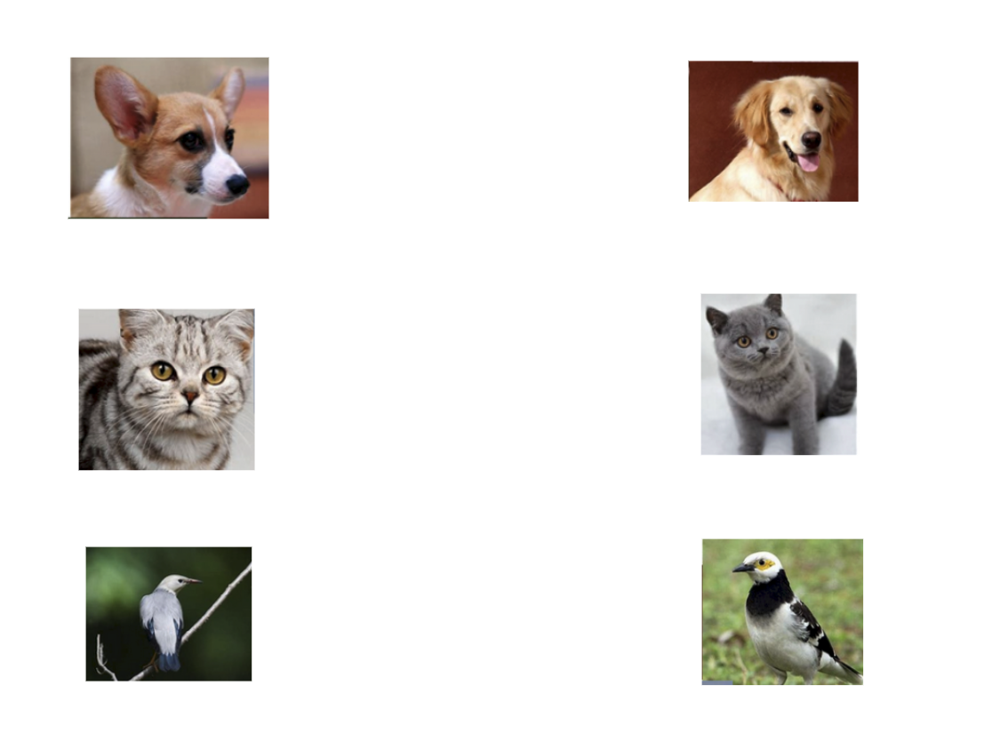
Dataset

Slide 34
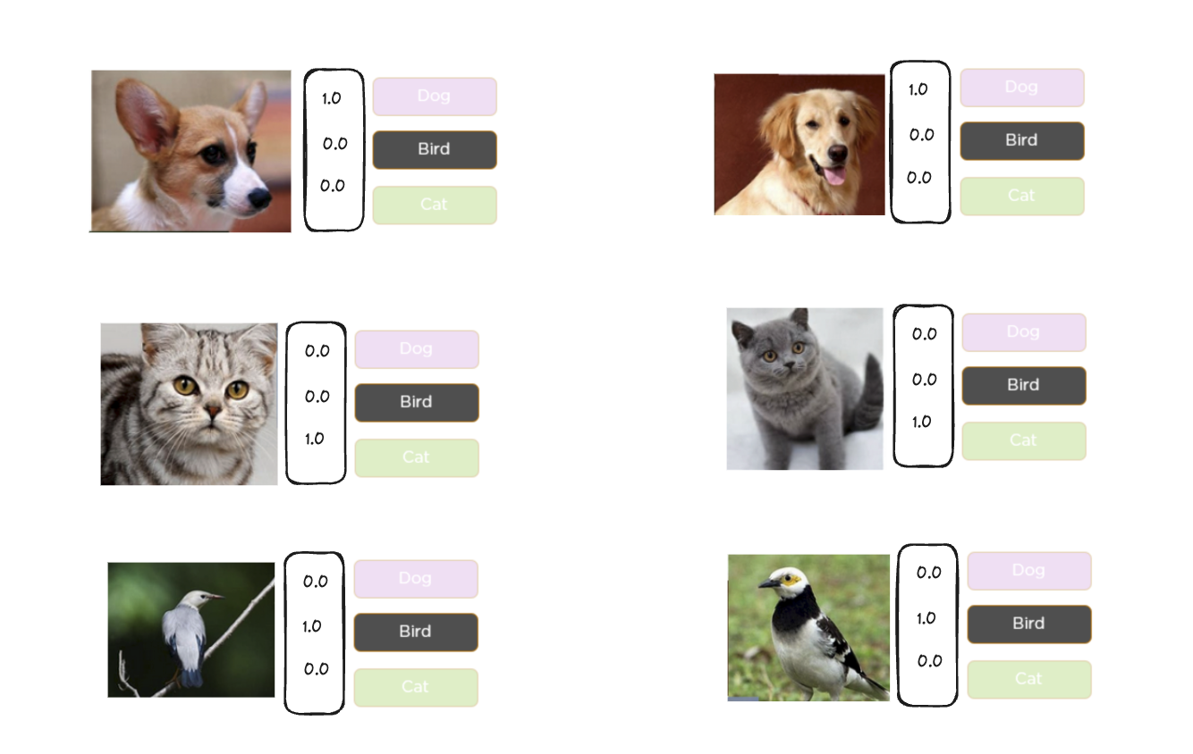
Dataset with Labels

Slide 35
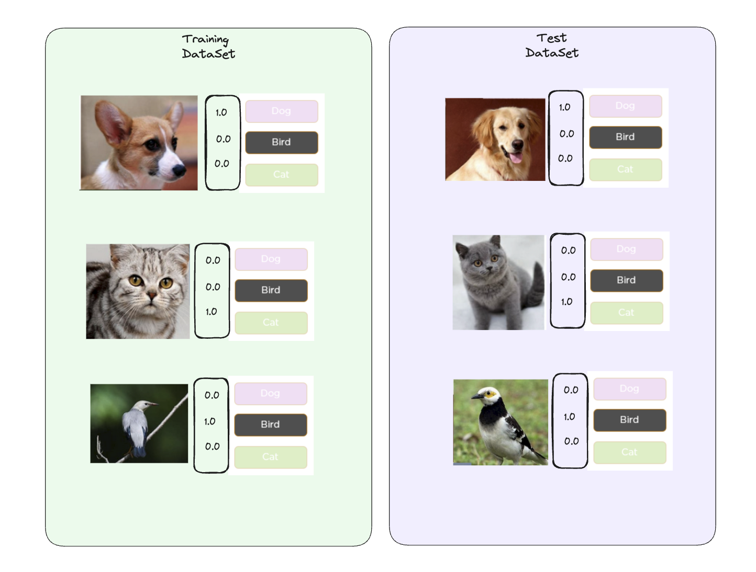
Train/Test split

Slide 36
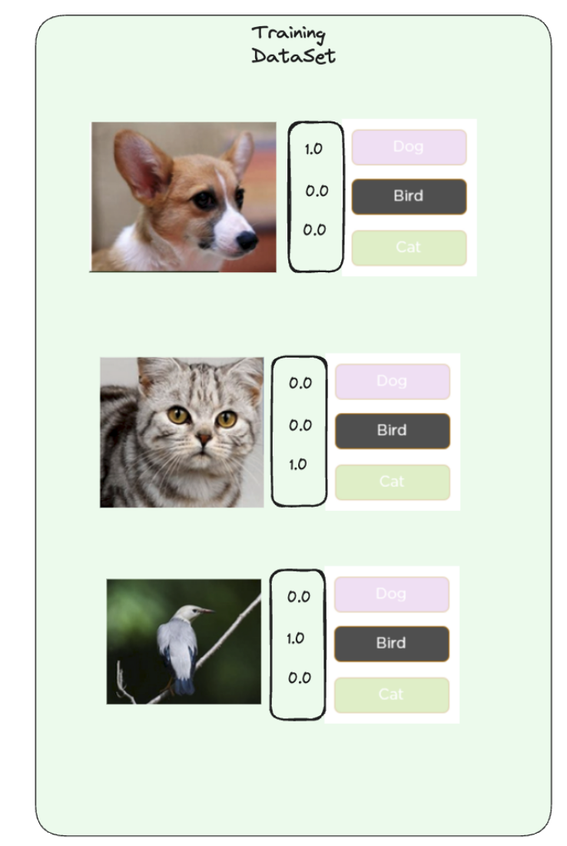
Supervised Learning

Slide 37
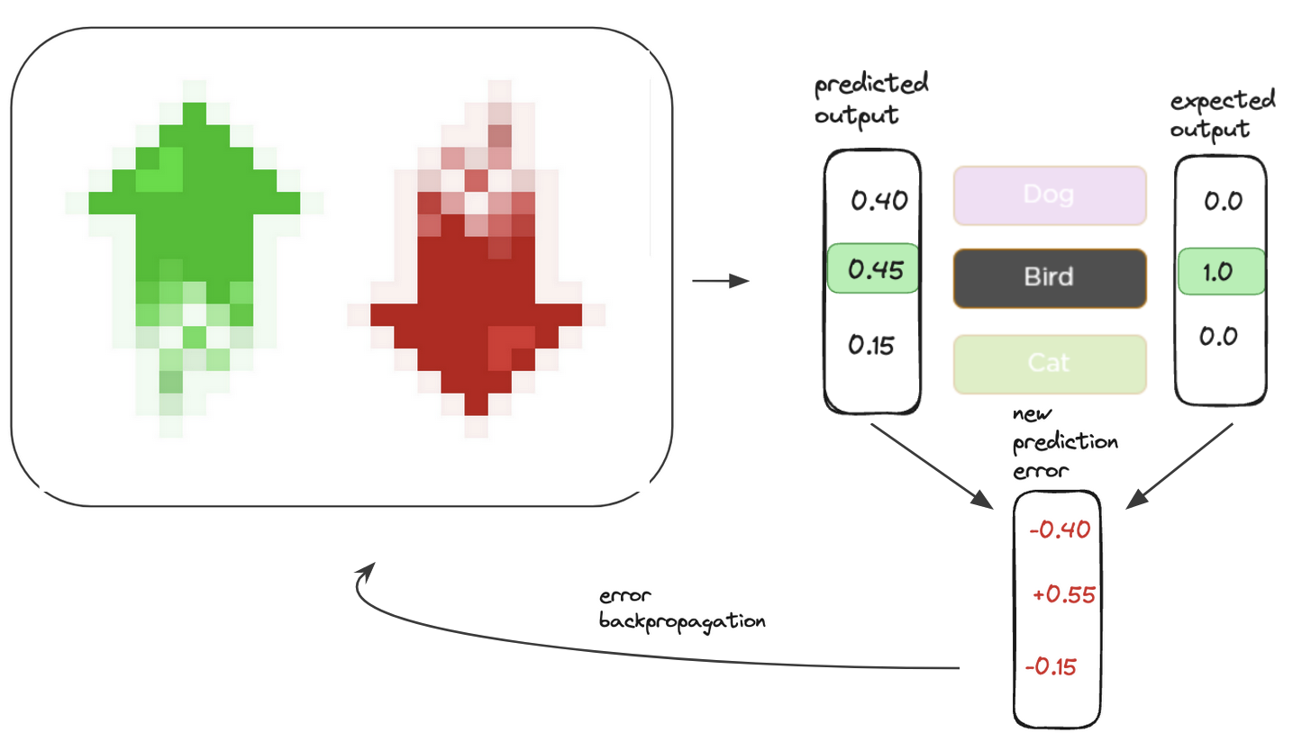
Supervised Learning

Slide 38
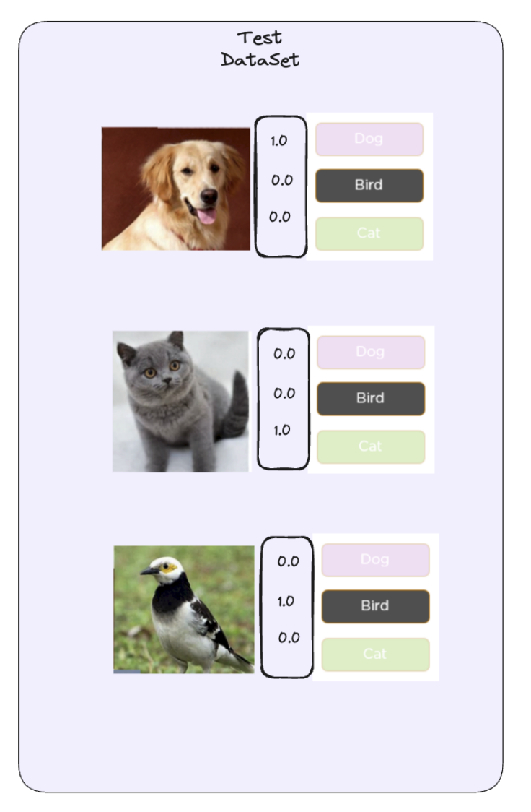
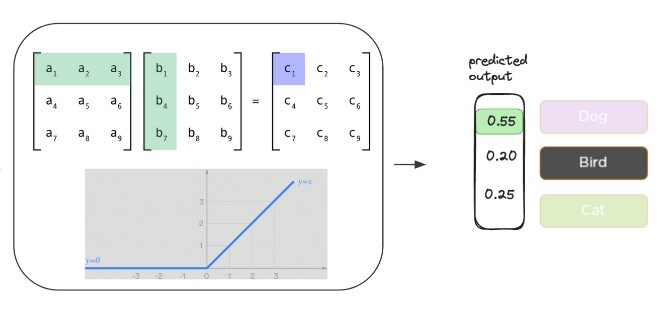
Evaluation

Slide 39
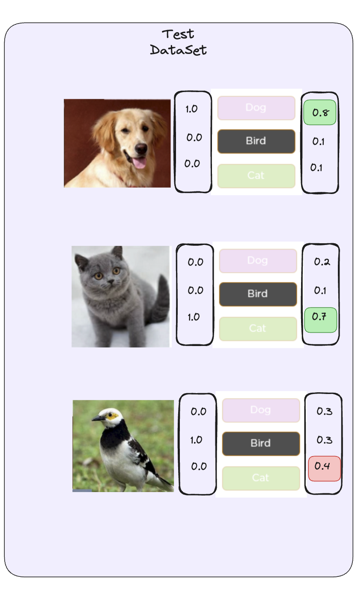
Evaluation

Slide 40


Evaluation

Slide 41
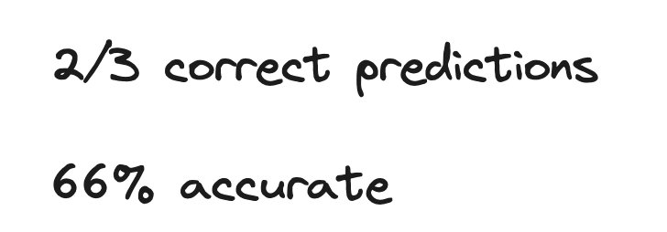
Evaluation

Slide 42
Key Challenge - Good Dataset creation
Better the Dataset > Leads to better ML model

Slide 43
Key Challenge - Good Dataset creation

Slide 44
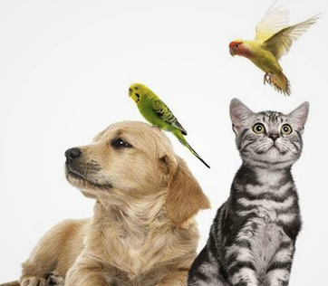
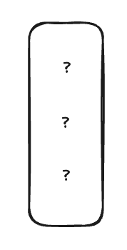
Key Challenge - Good Dataset creation

Slide 45
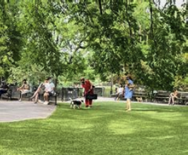
Key Challenge - Good Dataset creation

Slide 46
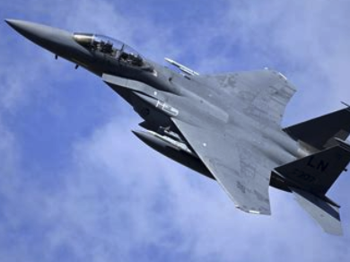
Key Challenge - Good Dataset creation

Slide 47
Key Challenge - Good Dataset creation
Lots of human effort (time & money)
Quality issues (consistency between human labelers, mistakes)

Slide 48
How Language Models Learn?

Slide 49
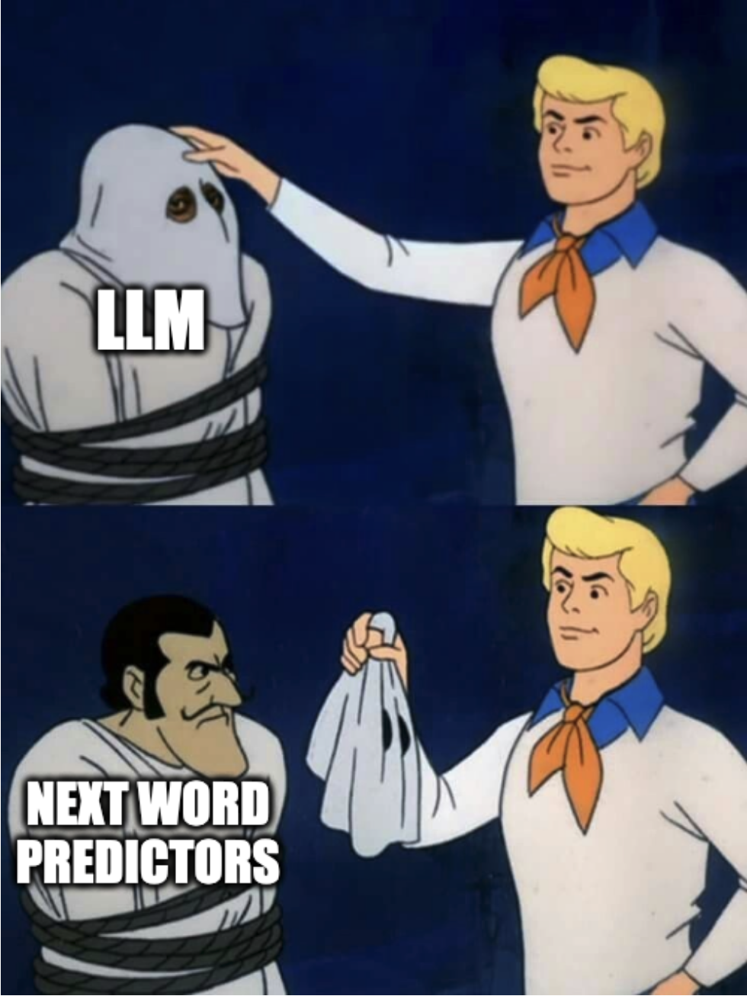

Slide 50
Let’s build a toy Language Model

Slide 51
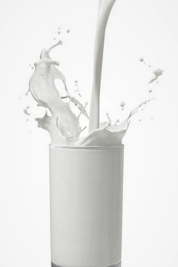
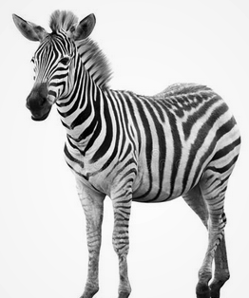
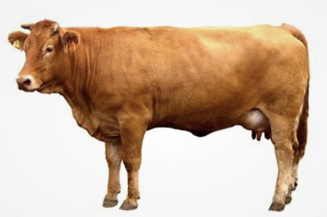
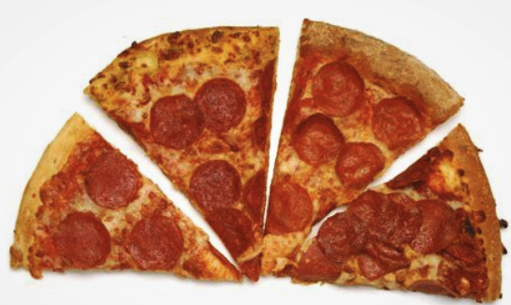
Baby Language

Slide 52
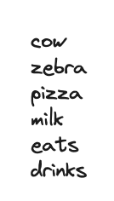
Baby Language

Slide 53
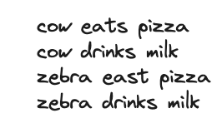
Baby Language

Slide 54

Baby Language Model

Slide 55


Baby Language Model

Slide 56

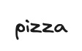
Baby Language Model

Slide 57
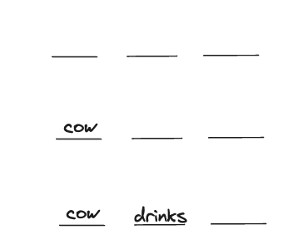
Baby Language Model

Slide 58
Baby Language Model

Slide 59
Baby Language Model

Slide 60
Machine Learning Model Creation
What is our input?
What is our output?
(What is our model architecture?)
What is our learning algorithm?

Slide 61
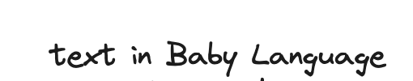
Baby Language Model
What is our input?

Slide 62
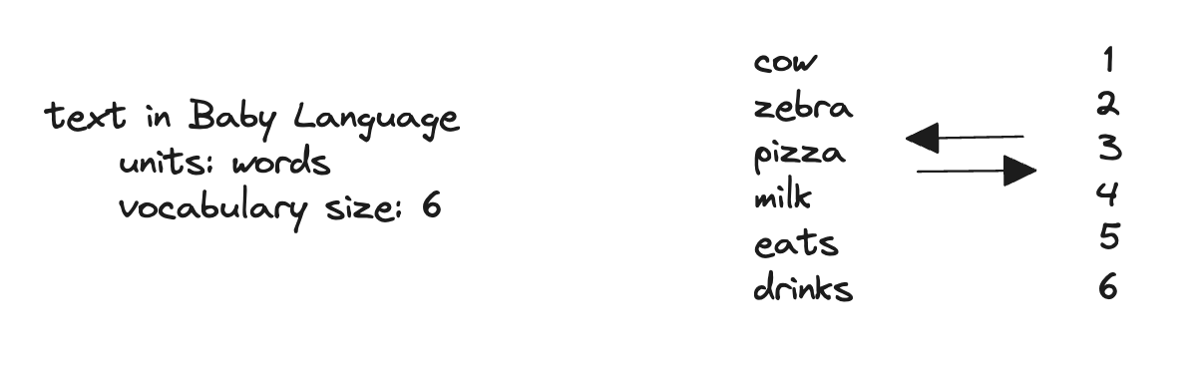
Baby Language Model
What is our input?

Slide 63
Baby Language Model
What is our input?

Slide 64
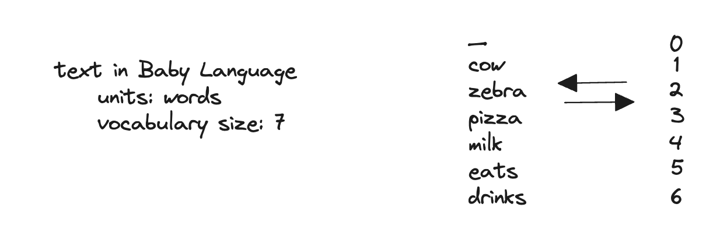
Baby Language Model
What is our input?

Slide 65

Baby Language Model
What is our input?

Slide 66
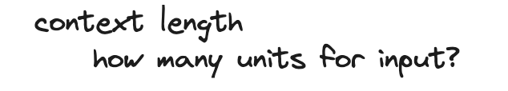
Baby Language Model
What is our input?

Slide 67
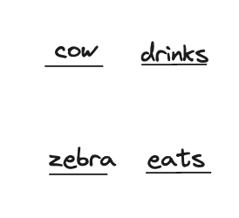

Baby Language Model
What is our input?

Slide 68


Baby Language Model
What is our input?

Slide 69

Baby Language Model
What is our input?

Slide 70
Baby Language Model
2. What is our output?

Slide 71

Baby Language Model
2. What is our output?

Slide 72


Baby Language Model
2. What is our output?

Slide 73


Baby Language Model
2. What is our output?

Slide 74
Baby Language Model
2. What is our output?

Slide 75

Baby Language Model
2. What is our output?

Slide 76

Baby Language Model
2. What is our output?

Slide 77
Baby Language Model
3. (What is our model architecture?)

Slide 78

Baby Language Model
3. (What is our model architecture?)

Slide 79

Baby Language Model
3. (What is our model architecture?)

Slide 80


Baby Language Model
3. (What is our model architecture?)

Slide 81
Baby Language Model
4. What is our learning algorithm?

Slide 82

Baby Language Model
4. What is our learning algorithm?

Slide 83

Baby Language Model
4. What is our learning algorithm?

Slide 84
Baby Language Model
4. What is our learning algorithm?

Slide 85

Baby Language Model
4. What is our learning algorithm?

Slide 86

Baby Language Model
4. What is our learning algorithm?

Slide 87
Baby Language Model
4. What is our learning algorithm?

Slide 88

Baby Language Model
4. What is our learning algorithm?

Slide 89
Baby Language Model
4. What is our learning algorithm?

Slide 90
Baby Language Model
4. What is our learning algorithm?

Slide 91
Baby Language Model
4. What is our learning algorithm?

Slide 92
Baby Language Model
4. What is our learning algorithm?

Slide 93
Machine “Learning”

Slide 94
Machine “Learning” Training Loop

Slide 95
Machine “Learning” Training Loop

Slide 96

Dataset

Slide 97

Dataset

Slide 98

Dataset

Slide 99

Dataset

Slide 100
Dataset

Slide 101

Self-supervised learning

Slide 102
Supervised learning

Slide 103
Animal classifier

Slide 104
Machine “Learning” Training Loop

Slide 105
Key Challenge - Good Dataset creation

Slide 106
Key Challenge - Good Dataset creation

Slide 107
Key Challenge - Good Dataset creation

Slide 108
Key Challenge - Good Dataset creation

Slide 109
Key Challenge - Good Dataset creation
Lots of human effort (time & money)
Quality issues (consistency between human labelers, mistakes)

Slide 110
Llama-3 Demo

Slide 111



Llama-3 by

Slide 112

Llama-3 by

Slide 113
Can we estimate Model Size?

Slide 114


Can we estimate Model Size?

Slide 115
Can we estimate Model Size?

Slide 116
1 Parameter == 1 Number (floating point)
 | 16 bit float
Llama3-8B | ~16 GB (8*10^9 * 2B)
Llama3-70B | ~140 GB (70*10^9 * 2B)
Llama3-400B | ~800 GB (400*10^9 * 2B)

Slide 117

Quantization

Slide 118
Quantization
Compression method
PTQ (Post Training Quantization) - easy to implement, degrades performance slightly
QAT (Quantization Aware Training) - happens during training stage, more complicated to implement, but results in better performance than (PTQ)

Slide 119
1 Parameter == 1 Number (floating point)
 | 16 bit float | Quantized (Q8_0) GGUF
Llama3-8B | ~16 GB (8*10^9 * 2B) | ~9 GB
Llama3-70B | ~140 GB (70*10^9 * 2B) | ~75 GB
Llama3-400B | ~800 GB (400*10^9 * 2B) | N/A

Slide 120

1 Parameter == 1 Number (floating point)
 | 16 bit float | Quantized (Q8_0) GGUF
Llama3-8B | ~16 GB (8*10^9 * 2B) | ~9 GB
Llama3-70B | ~140 GB (70*10^9 * 2B) | ~75 GB
Llama3-400B | ~800 GB (400*10^9 * 2B) | N/A

Slide 121
Llama-3 by

Slide 122

Tokenization

Slide 123
Tokenization

Slide 124


Tokenization

Slide 125


Tokenization

Slide 126
Tokenization

Slide 127
Llama-3 by

Slide 128

Llama-3 by

Slide 129
Temperature

Slide 130

Temperature

Slide 131
Sampling methods
Deterministic - greedy (best 1) / beam (best 3)
Probabilistic - pick a random value, proportional to predicted probabilities

Slide 132
Temperature parameter
Rescale probabilities before sampling, control the shape of the distribution

Slide 133


Temperature parameter
Rescale probabilities before sampling, control the shape of the distribution
Decreasing T - “conservative” - peaks increased, promote frequent - suppress rare tokens

Slide 134


Temperature parameter
Rescale probabilities before sampling, control the shape of the distribution
Decreasing T - “conservative” - peaks increased, promote frequent - suppress rare tokens
Increasing T - “creative” - flatten distribution - rare tokens become more likely

Slide 135

Top-k or Top-p sampling
Top-k
only choose from the k highest prob tokens, ignore bottom
Top-p
only choose from top prob tokens, which sum to p, ignore bottom %

Slide 136
Base Model
Vs
Chat/Instruct Model

Slide 137


Slide 138

LLM creation

Slide 139
Instruction/Chat dataset

Slide 140

Instruction/Chat dataset

Slide 141


Instruction/Chat dataset

Slide 142
Instruction/Chat training using new dataset
Model learns to follow the new format:
<USER> instructions <ASSISTANT>

Slide 143
Fine-tuning - to human preference

Slide 144

Comparison fine-tuning
Comparing is easier then coming up with an answer

Slide 145
Human Preference dataset

Slide 146

Llama2 vs Llama2-chat

Slide 147

Base Model vs Instruction Tuned Model

Slide 148
Multi-turn conversation
<USER> instructions <ASSISTANT>

Slide 149

Multi-turn conversation

Slide 150

Multi-turn conversation

